Slide 1
Assortivity Location Matrix Example

Slide 2
Spread of Disease From One City to Another
City A
STI Epidemic
Goal: Use Individual Property and Assortivity to model the STI epidemic spreading from City A to City B.
90% of population infected at outbreak.
Total Population = 175,000
City B
Zero Cases
For every one person in Rural area there are 3 in the suburban and 5 in the urban.
“Initial_Distribution”
 | 1 | 2 | 3 | 4 | 5
1 | 5 | 3 | 1 | 1 | 1
2 | 3 | 3 | 1 | 1 | 1
3 | 1 | 1 | 1 | 1 | 1
4 | 1 | 1 | 1 | 3 | 3
5 | 1 | 1 | 1 | 3 | 5
 | 1 | 2 | 3 | 4 | 5
1 | 0.12 | 0.07 | 0.02 | 0.02 | 0.02
2 | 0.07 | 0.07 | 0.02 | 0.02 | 0.02
3 | 0.02 | 0.02 | 0.02 | 0.02 | 0.02
4 | 0.02 | 0.02 | 0.02 | 0.07 | 0.07
5 | 0.02 | 0.02 | 0.02 | 0.07 | 0.12

Slide 3
Weighting Matrix Based On Distance
The further away two people are the lower the probability of starting a relationship. I quadrupled the distance to really exaggerated this but not allow zero.
W = 1 / { [ (2 – 1)^2 + (1 – 5)^2 ]^2 + 1} = 0.003

Slide 4
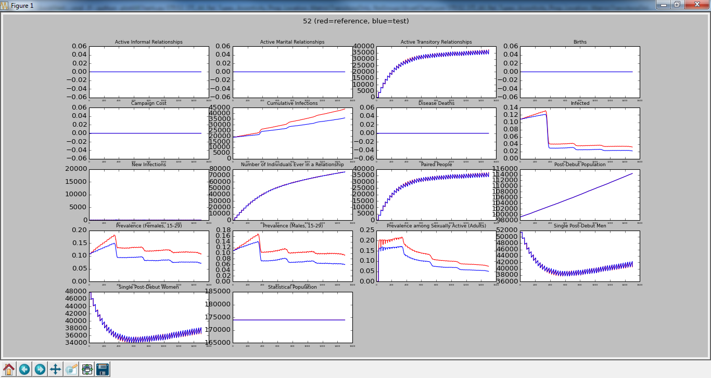
Red is Transitory Only with No Groups Blue is Transitory Only with Matrix
Metrics go down as expected, but I would have thought they’d go down more.

Slide 5
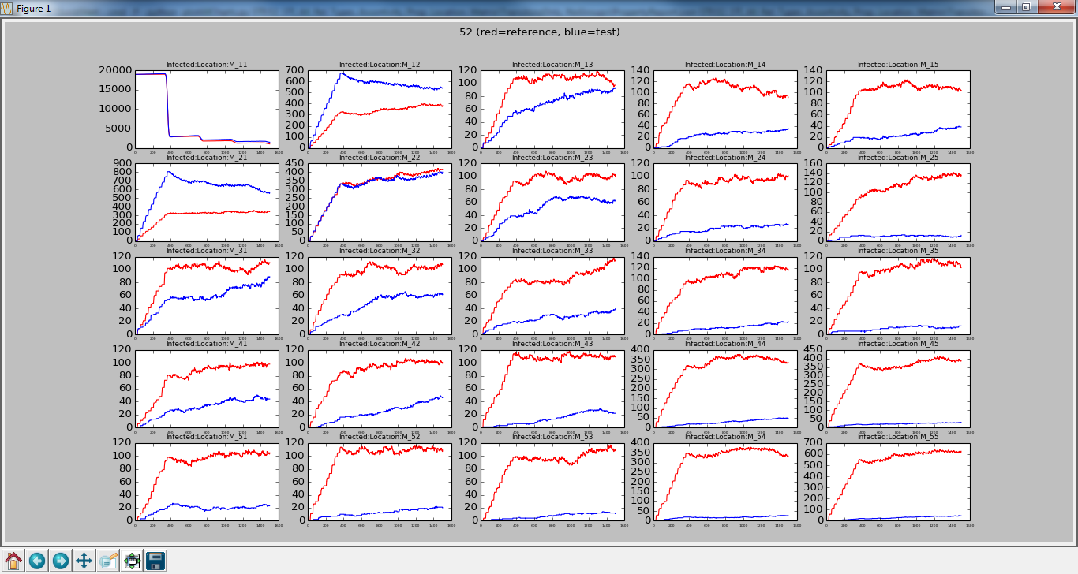
Red is Transitory Only with No Groups Blue is Transitory Only with Matrix
City A
# Infected Per Property (i.e. Location)
With Assortivity, we see a significant drop in the # of infected people the further away you get from City A
City B

Slide 6
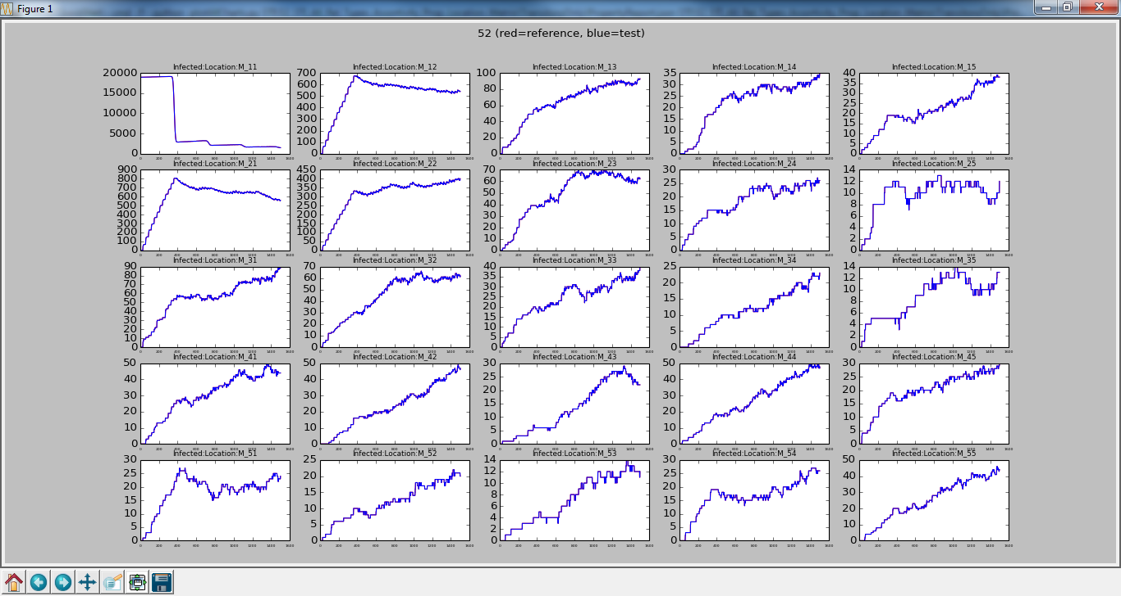
Zoom In Blue is Transitory Only with Matrix
City A
# Infected Per Property (i.e. Location)
The weighting value for starting a relationship with a person in City A and a person in City B was not zero so we did have relationships starting near the beginning of the simulation. I was hoping to see it say lower until the disease had time to spread.
City B

Slide 7
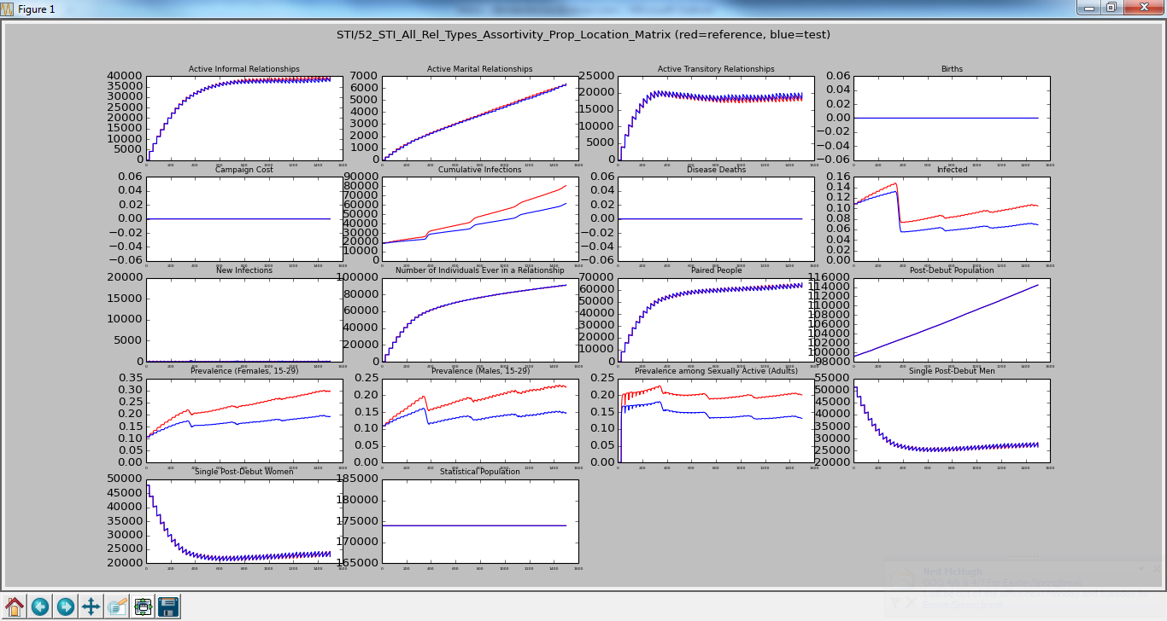
Red is All Rel Types with No Groups Blue is All Rel Types with Matrix
With Assortivity, we see a drop in the number infected because Assortivity keeps the disease from spreading.

Slide 8
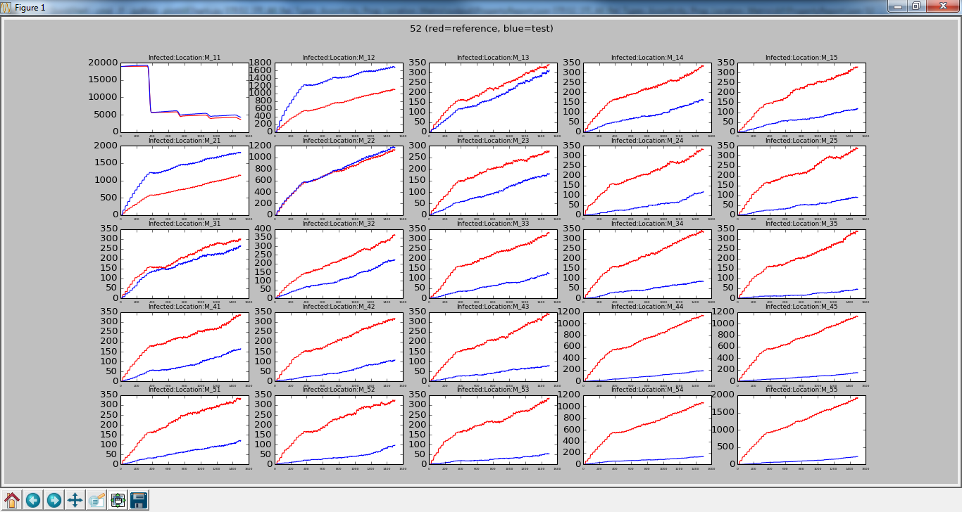
Red is All Rel Types with No Groups Blue is All Rel Types with Matrix
City A
# Infected Per Property (i.e. Location)
Again, we see Assortivity keeping the # of infected lower the further away you get from City A.
City B

Slide 9
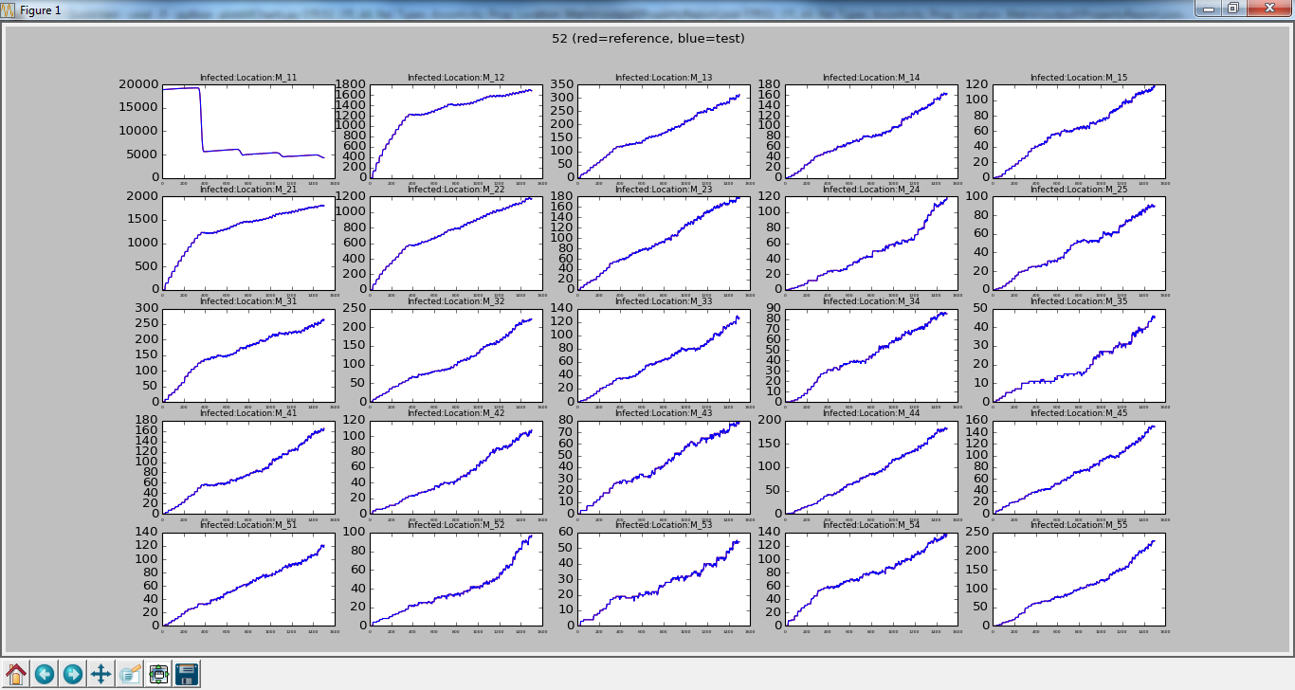
Zoom In Blue is All Rel Types with Matrix
City A
# Infected Per Property (i.e. Location)
I’m still a little bothered by how City B gets infections so early, but without zeros, you are going to get some relationships formed with people in City A and B.
City B

Slide 10
Change Matrix to Have Zeros
Just remove a decimal of percision

Slide 11

Red is All Rel Types with No Groups Blue is All Rel Types with Matrix w/ 0’s
Very subtle, if not noise, changes between this and the previous matrix.

Slide 12
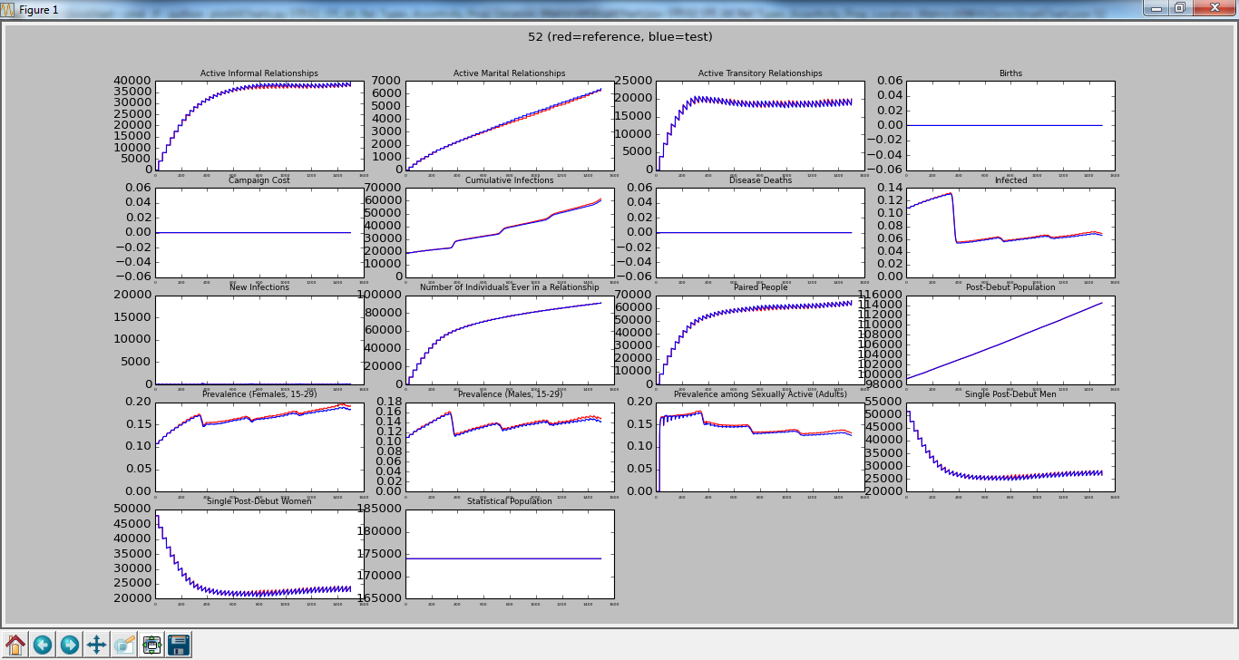
Red is All Rel Types with Matrix Blue is All Rel Types with Matrix w/ 0’s
Direct comparison really emphasizes not much difference in high level numbers.

Slide 13
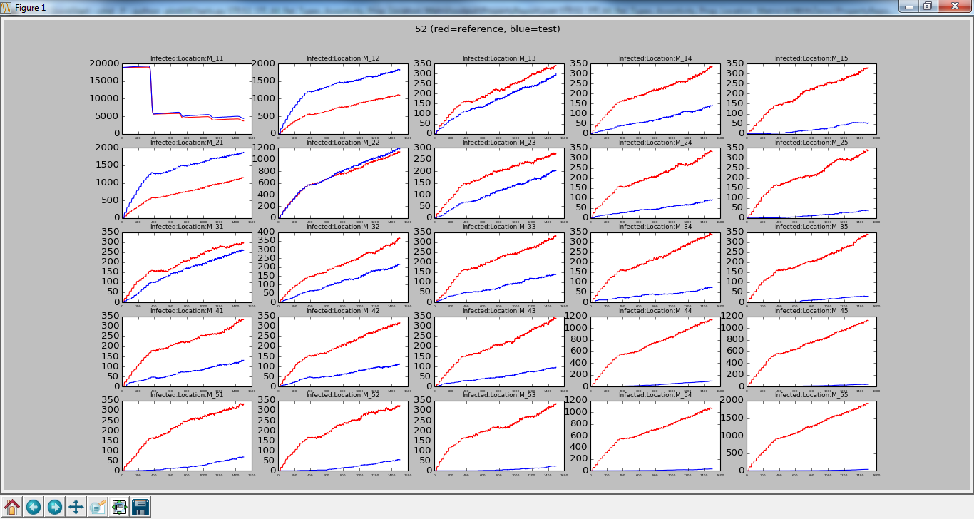
Red is All Rel Types with No Groups Blue is All Rel Types with Matrix w/ 0’s
City A
# Infected Per Property (i.e. Location)
The zeros did drive the down the number infected in areas further away from City A.
City B

Slide 14
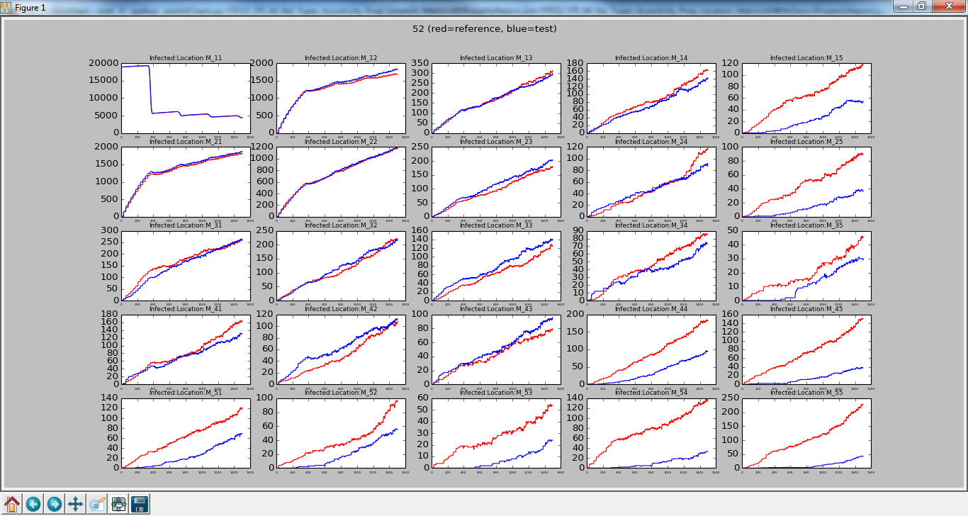
Red is All Rel Types with Matrix Blue is All Rel Types with Matrix w/ 0’s
City A
# Infected Per Property (i.e. Location)
If the cumulative # of people infected didn’t change much, I’m a little confused on how I’m getting the same number when the further away zones have less infected. I don’t see the closer zones making up the difference. Hmm.
City B

Slide 15
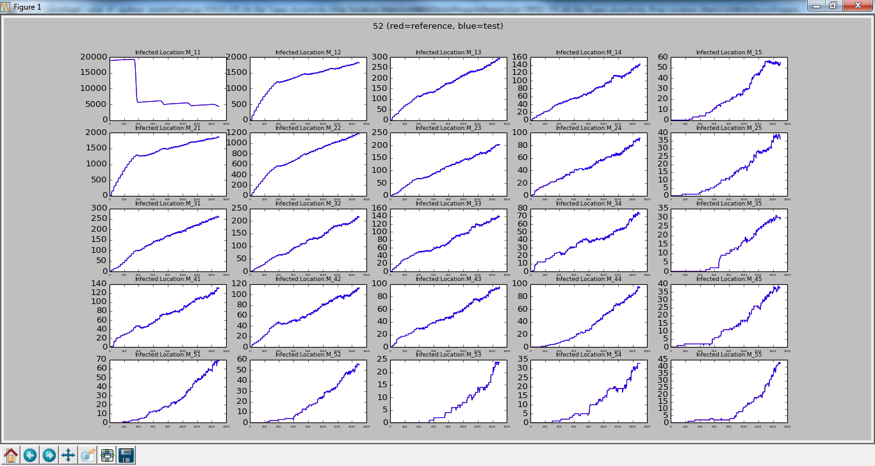
Zoom In Blue is All Rel Types with Matrix w/ 0’s
City A
# Infected Per Property (i.e. Location)
This is what I wanted to see!!! A few zeros forced the transmission from City A to City B to go through another zone.
City B

